Slide 1
Application of STPA on Small Drone Operation: The Approach and First Results.
HELLENIC AVIATION SOCIETY
4th Aviation Conference
Athens, 10 - 11 May 2016

Slide 2
Authors
Anastasios Plioutsias
PhD student, School of Mechanical Engineering, Sector of Industrial Management and Operational Research, National Technical University of Athens, Greece.
Dr Nektarios Karanikas
Associate Professor of Safety & Human Factors, Faculty of Technology, Aviation Academy, Amsterdam University of Applied Sciences, Netherlands.
Dr Maria Mikela Chatzimichailidou
Research Associate in Healthcare Engineering Design Centre, University of Cambridge, United Kingdom.

Slide 3
Overview
Background
Research scope and assumptions
Application of the STPA and results
Comparison of four drones and statistical analysis
Conclusions and next steps

Slide 4
Background
Small drones are a new “toy” for everyone. Used for entertainment reasons.
A great amount of drones is sold and used.
No solid regulatory framework for drones’ manufacturing and operation.
Operator is fully responsible for safe use of drone.
Several reported accidents (incl. human injuries).
Notes:
Based on the new reality and the unstopped advancements in small drone technology and capabilities, this study will apply STPA on small drone operations.

Slide 5
Drones: A new reality
Notes:
Ποσα χιλιαδες dronew πολουνται ο καθε ενας τα αγοραζει
Μια νεα πραγματηκοτητα που το authority δεν εχει πλαισιο διαχειργσγς των drone

Slide 6
Research scope
An analysis of the operator – drone system with STPA.
Safety Requirements (SR) to be considered in certification and standardization.
SR for: regulator, manufacturer, operator and automation
Comparative analysis among four popular drone models with detailed user manuals.
Notes:
It will provide a list of hazards and causal factors that might lead to unwanted events. The results of this analysis will suggest the
types and amount of activities a drone operator needs to continuously perform in order to
ensure a safe flight, providing thus a qualitative assessment of the operator’s task load. In this
phase, it will be assumed that the operator conforms with the requirements of the regulator
and the maintenance instructions of the manufacturer.
The analysis might be used as a reference for engineers in order to introduce proper
level of automation and relief some task load from the operator and making drone flying
experience more entertaining and safe at the same time. Also, buyers will be in a position to
evaluate each drone type based on the constraints that their system will automatically
maintain without, however, excluding the end‐user from the control loop and minimizing
flight experience.

Slide 7
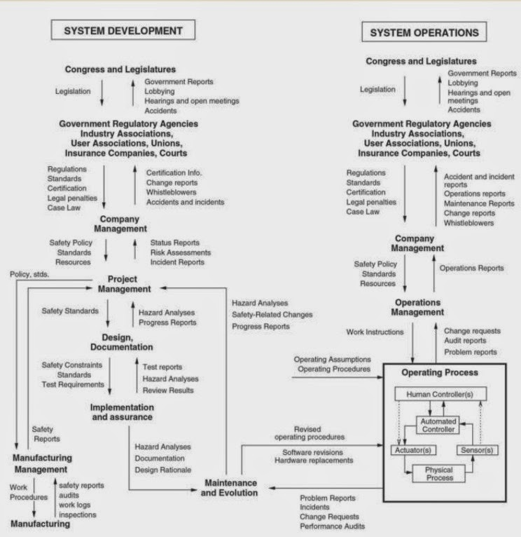
STAMP

Slide 8
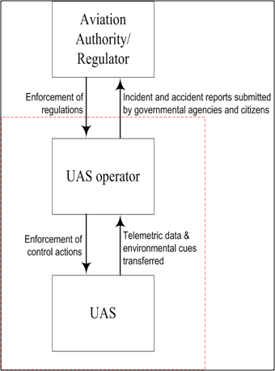
High level hierarchical control structure

Slide 9
STPA
Accident definition
Injuries or property damage resulting from the operation of UAS.
Hazards
[H1]: Unsafe separation from terrain / objects on ground during controlled flight
[H2]: Uncontrolled flight over congested area
[H3]: Unsafe separation from other flying objects during controlled flight

Slide 10
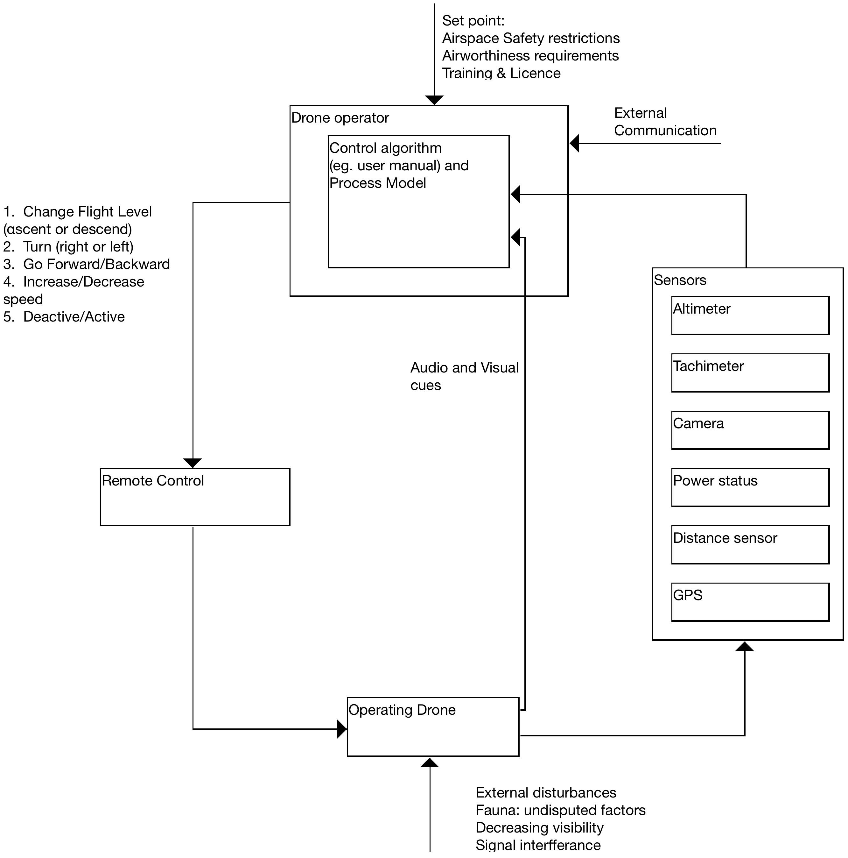
Control structure
Notes:
For each controller in the control structure define:
a) its responsibilities: The operator is responsible for the safety of the operation. He/she must adhere to restrictions and follow instructions published by the authorities and the manufacturer.
b) the variables which are needed for their process of mental models: The operator needs to know the state and position of the drone, and environmental conditions, such as weather and other traffic.

Slide 11
Example of (Unsafe) Control Action – STPA step 1
Control Action (CA) | Hazardous/Unsafe Control Actions (UCA)
 | Not Providing Causes Hazard | Providing Causes Hazard | Applied Too Early/ Too Late/ Wrong Order Causes Hazard | Stopped Too Soon or Applied Too Long Causes Hazard
[CA1] ascend | [UCA1] Operator does not provide ascend command when drone approaches lowest altitude of range area. [H-1] | [UCA2] Operator provides ascend command when drone close and beneath flying object. [H-3] [UCA3] Operator provides ascend command when drone approaches highest altitude of range area. [H-2, H-3] | [UCA4] Operator provides ascend command before drone passes beneath object flying over and close. [H-3] [UCA5] Operator provides ascend command after drone having crossed lowest altitude of range area. [H-1] | [UCA6] Operator applies ascend command too long when traffic above. [H-3]

Slide 12
Example of Casual Factors – STPA step 2
Event | Causal factors/ flaws
UAS failure [H2] (By saying UAS we mean the three sub-systems: the remote control, the display, and the drone). | 1. Inherent technical flaws (i.e. design and/or production) 2. Excessive environmental conditions (e.g. humidity, high / low temperature) [applicable for hardware] 3. Unintentional drop prior to the flight 4. Inadequate maintenance
Interruption of communication between remote controller – drone and/or drone – display [H2] (In addition to UAS failures) | 5. Signal disruption due to frequency interference 6. Signal disruption due to physical impenetrable obstacle
Ineffective communication between UAS operator – display [H1, H2, H3] (In addition to display failures) | 8. Limited visibility of display (e.g., glare, angle of view, reflections of environment) 9. Indiscernible information on the display (e.g., size of fonts and symbols, colors) 10. Unfamiliarity of operator with terms / language used

Slide 13
Examples of Safety Requirements
Operator accomplishes familiarization stages for UAS operation
Operator physically fit to fly UAS
Designate flight areas with a minimum altitude TBD at least equal to the highest physical obstacle
Designate flight areas considering other scheduled flying activity (maximum altitude and radius)
Designate flight areas considering electromagnetic fields
Operations when weather minima are met
Land when any communication problem occurred during flight
Aural notifications when drone lower than TBD altitude
Visual notifications when drone lower than TBD altitude
Land when not meeting environmental conditions into which UAS will maintain reliability
Take-off when meeting environmental conditions into which UAS maintain reliability
Display provides information for UAS mode
Display provides information for proximity to range area
Generate aural warning when drone reaches or violates range limits
Prioritize actions, alerts and messages to facilitate operator’s reaction under emergency
Drone shall decrease speed and/or go backward when approaching boundaries of range area
Drone shall not be deactivated when airborne
Notes:
Some of 68 Safety Requirements. Full list is published in paper.

Slide 14
STPA Results
9 CA.
38 UCA.
18 Causal factors.
68 Safety Requirements.
One (1) Safety Requirement is only for the Aviation Authority.
Total 67 requirements included in the analysis.

Slide 15
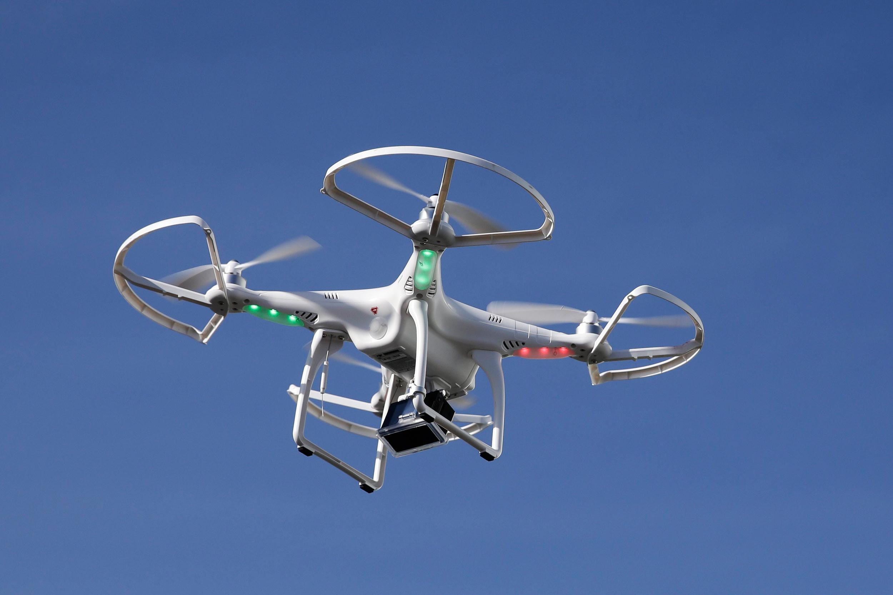
Comparison
Four drones:
No 1, France, 349 Euro.
No 2, China, 4330 Euro.
No 3, China, 900 Euro.
No 4, USA, 840 Euro.

Slide 16
Frequency of Requirements fulfilled for Manufacturer

Slide 17
Frequency of Requirements Fulfilled for Operator

Slide 18
Frequency of Requirements Fulfilled for Automation

Slide 19
Intraclass Correlations
All SRs | Statistics intraclass Correlations all drones | Intraclass Correlations (In Pairs) | Spearman’ s correlations Significance - Coefficient (for price)
Manufacturer | 0.561 | 0.286 / 0.925 | 0.051/0.949
Operator | 0.618 | 0.388 / 0.829 | 0.600/0.400
Automation | 0.53 | 0.32 / 1 | 0.051/0.949
Notes:
Cochran test
ποσο συμφωνουν μεταξυ τους τα 4 δρονε
Περνουν απολυτες τιμές 0 και 1 οπου 0 η ελαχιστη και 1 η μεγιστη συμβατοτητα , πρωτη στηλη με τα SR, δευτερη μεταξυ τους
αν και ικανοποιοουν το Η2 στα υψηλοτερα frequency το καθε δρονε ικανοποιει διαφορετικά requirment
we have high correlation at level of manufacturer and automation but although the small sample the see the tendency in significance tha the most requirments are met the higher price for the drone.

Slide 20
Conclusions
STPA drove to systematic identification of 67 SR.
The framework can be used for drones’ design, certification and safety benchmarking.
The examined drones are compliant with 36.2% to 72.7% of the SRs.
Similarities between drones:
Manufacturer from 0,286 to 0,925.
Operator from 0,388 to 0,829.
Automation from 0,32 to 1.
Drones meeting the most of the SRs tend to have higher price .

Slide 21
Next steps
Compare the drones’ regulatory framework of Aviation Authorities.
Make comparisons among more drones.
Compare the STPA results with other published hazard analyses (e.g., Dalamagkidis, Valavanis, & Piegl, 2012).

Slide 23
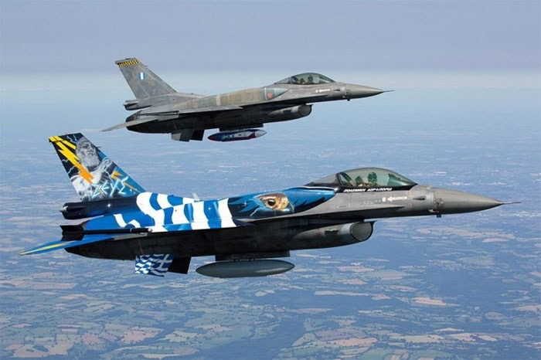
Questions?
Thank you for your attention!

